Slide 1
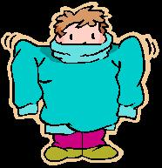
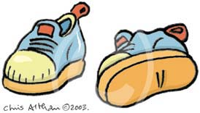
Free Clothes Give Away
Host by : Temple Of Faith M.B. Church
Location: 2631 Kienlen Saint Louis MO
NO SIGN-UP
Every 2nd & 4th Saturday
TIME: 10: 00 AM to 2:00 PM
FREE Adult Clothes
FREE Children Clothes
FREE SHOES
Pastor Sam Palmore

